Slide 1


Bachelor of Business Administration Program in Innovation Management (Bilingual Program)
Notes:
© Copyright PresentationGO.com – The free PowerPoint and Google Slides template library

Slide 2
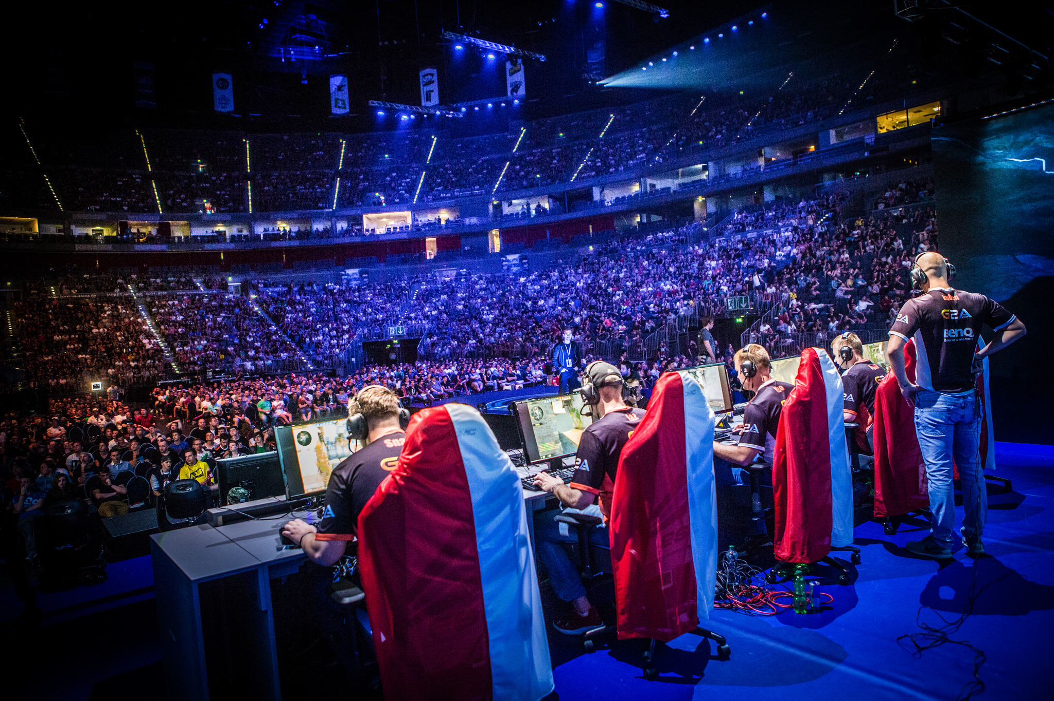
Innovation Management in eSports and Games Business
Notes:
© Copyright PresentationGO.com – The free PowerPoint and Google Slides template library

Slide 3

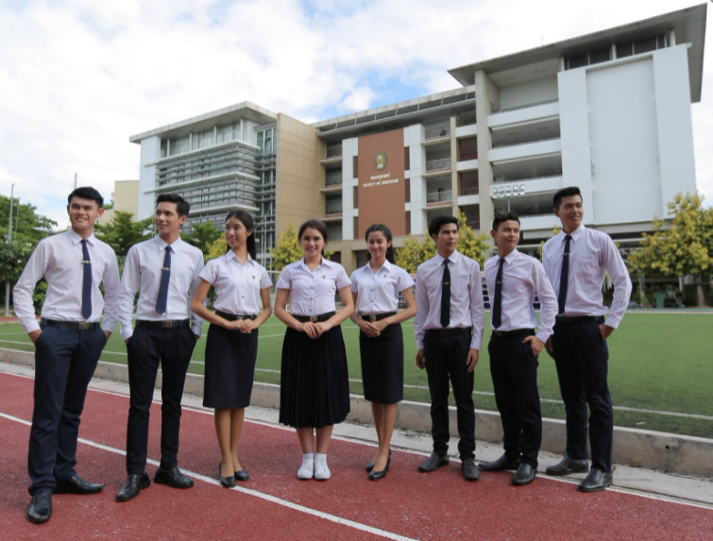
Suan Sunandha Rajabhat University
Suan Sunandha Rajabhat University was established in 1937. It is the number 1 Rajabhat University in Thailand with 3 campuses where one is located in Bangkok and the other two campuses are located in Suburb. Suan Sunandha Rajabhat University has now become a Rajabhat University which including bachelors, masters, and doctoral degree in many faculties and programs.
Notes:
© Copyright PresentationGO.com – The free PowerPoint and Google Slides template library

Slide 4

Program Philosophy The philosophy of our program is to produce graduate with knowledge ,acadamic leader and well perform in business worlds through Effective Innovation Management for increase business competitiveness in the globalization era. Moreover, our graduate must qualify full of morality and ethics to being a world citizen
Notes:
© Copyright PresentationGO.com – The free PowerPoint and Google Slides template library

Slide 5

Program Significance
Globalizations bring the world closer to each other which mean a massive exchange of information that led innovation and technology evolved rapidly. Innovation play an important role for enhancing the potential and creating a business competitive in the business world.
From this reason, this curriculum was developed by emphasizes the basic theory knowledge and practice-based learning strategy together to create learning environment. Moreover, this program consists of expertise and people with experience in the innovation management profession. The program prefers to create an Innovator for new business industry that is highly demand in the professional labor market.
Notes:
© Copyright PresentationGO.com – The free PowerPoint and Google Slides template library

Slide 6
Curriculum Structure
Notes:
© Copyright PresentationGO.com – The free PowerPoint and Google Slides template library

Slide 7

Core Course
CIM1106 Statistics and Business Research
CIM1121 Innovation Management
CIM1122 Innovation Management of Human Resources
CIM1123 Organizational Management in The Digital Era
CIM1124 Economics for Business Innovation
CIM2101 Strategic Management
CIM2102 Principles of Accounting
CIM2121 Digital Marketing
CIM2123 Financial Innovation
CIM3121 Business Ethics and Law
Notes:
© Copyright PresentationGO.com – The free PowerPoint and Google Slides template library

Slide 8

Required Course
ESG2201 Game Analysis and Strategic
ESG2202 eSports Facility and Equipment Management
ESG4201 eSports And Visual Design
ESM1201 Introduction to eSports
ESM1204 Digital Marketing for Game and eSports Business
ESM1205 Introduction to Event Management
ESM2201 Game and eSports Business
ESM2203 Psychology for Game and eSports Business
ESM2204 Principle of eSports Coaching
ESM2303 Introduction to Graphic Design
Notes:
© Copyright PresentationGO.com – The free PowerPoint and Google Slides template library

Slide 9
ESG3201 Start-up Thinking
ESG3202 Sports Science for eSports
ESG3203 Customer Behavior in the Digital Era
ESG3204 eSports Tourism Management
ESG3205 Business of eSports Agents
ESG3206 eSports Communication Promotion and Public Relations
ESG3501 Seminar on eSports
ESG4202 Creative Thinking and Story Telling
ESM1202 Data Communication and Network
ESM1203 Business Fundamentals for Information Technology Officer
ESM1302 Operating System
ESM3301 Data Structure and Algorithms
ESM2302 Distribution and Service of Game Online and eSports
ESM3303 Artificial Intelligence for Game and eSports Business
ESM2304 Principles of Casting
ESM2305 Fundamentals of Computer Programming
Elective Course
Notes:
© Copyright PresentationGO.com – The free PowerPoint and Google Slides template library

Slide 10









Education Collaborate
Notes:
© Copyright PresentationGO.com – The free PowerPoint and Google Slides template library

Slide 11
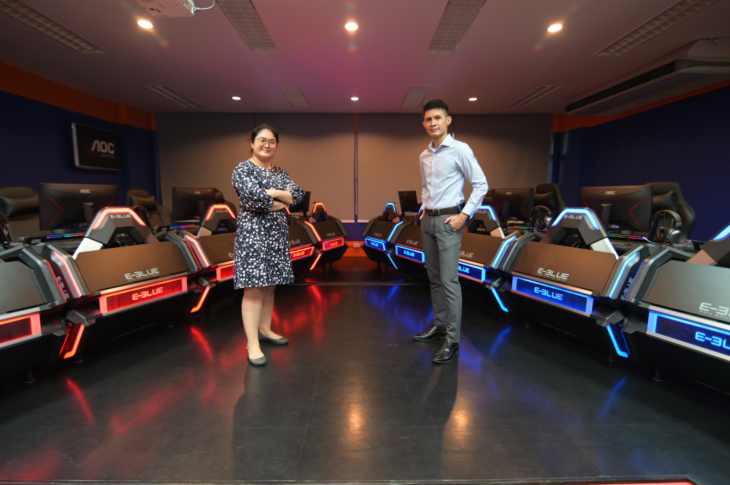
Careers after graduation
eSports Marketer
eSports Club Management
eSports Tournament Organizer
Distributors, Operators of eSports and Game products
Specialized careers in eSports such as Psychologists, Athletic trainers,
Shoutcaster, Live Broadcaster and eSports Scientist
Notes:
© Copyright PresentationGO.com – The free PowerPoint and Google Slides template library

Slide 12

Modern and Marketable Course
Focus on Theory with Real Practicing
Notes:
© Copyright PresentationGO.com – The free PowerPoint and Google Slides template library

Slide 13
Contact Us 37 Building， College of Innovation and Management, Suan Sunandha Rajabhat University 1 U-Thong nok Road, Dusit, Bangkok 10300 Tel.：+66-2-160-1182, +66-2-160-1183, Line ID: CIM Inter+bilingual+dual Taiwan/China Website: www.cim.ssru.ac.th Facebook Page: Bilingual วิทยาลัยนวัตกรรมและการจัดการ มหาวิทยาลัยราชภัฏสวนสุนันทา Wechat ID: golffywhang Email: benya.wh@ssru.ac.th Tel.: +66-92-261-7675
Notes:
© Copyright PresentationGO.com – The free PowerPoint and Google Slides template library

